Slide 1
Strategic Alternate Sourcing Program Office (SASPO)
Who We Are
Randy Harris
429 SCMS/GUMD
December 6, 2024
Version 1

Slide 2
Classification
The classification of the brief is unclassified and the discussion can go up to unclassified

Slide 3
Purpose
To provide 429 SCMS Strategic Alternate Sourcing Program Office (SASPO) Programs and Responsibilities

Slide 4
Agenda
Purpose
Strategic Sourcing Programs
Diminishing Manufacture Shortages and Material Shortages (DMSMS)
SASPO Products
Source Approval Requests (SAR)
Reverse Engineering/Repair Development (RE/RD)
Sustaining Engineering (SE)
Other Transaction Authority (OTA)
Points of Contact

Slide 5

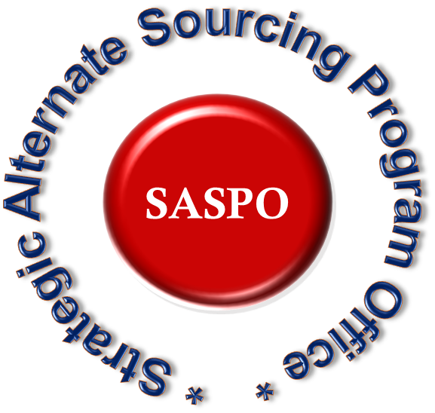





Strategic Alternate Sourcing Program Office (SASPO)
Diminishing Manufacturing Sources & Material Shortages (DMSMS)
Policy and Training (AFMCI20-105)
Predictive Tool (AVCOM)
Analysis & Resolution
Strategic Sourcing
Alternate Sourcing Strategies
Source Approval Requests (SARs)
Reverse Engineering/Repair Development (RE/RD)
Marketing Strategies
Other Transaction Authority (OTA)
End of Life (EOL)
Sustaining Engineering
Manages web-based tool MPST
Provides policy

Slide 6
SASPO Organizational Chart
Jerry Zamora
SASPO Supervisor
jerry.zamora@us.af.mil
Danny Meyers
DMSMS Facilitator
danny.meyers@us.af.mil
Randolph “Randy” Harris
Alternate Sourcing Facilitator
randolph.harris@us.af.mil
Kimberly Uselton
Sustaining Engineering Facilitator
kimberly.uselton@us.af.mil
Michael Deaton
Program Mgr/COR
A&R/ Predictive Tool Contracts
michael.deaton.1@us.af.mil
Danielle Knox
SCCI OTA Program Mgr
christina.knox@us.af.mil
Rayburn “Rae” Drinkwater
SE Project Mgr-Hill AFB
rayburn.drinkwater@us.af.mil
Raegan Richardson
SCCI OTA Program Mgr
Raegan.richardson@us.af.mil
Michael Graham
Policy and Training Program Mgr
michael.graham.4@us.af.mil
Steven A Wall
SE Project Mgr-Robins AFB
steven.wall.4@us.af.mil
Brian Butler
Program Mgr RE/RD
brian.butler.2@us.af.mil
Glen Norvell
SE Project Mgr-TAFB
Glenn.norvell@us.af.mil
Phil Gullatt
Program Mgr RE/RD
Phillip.gullatt.2@us.af.mil
Chaundra Sierra-Carmona
MPST Program Mgr
chaundra.sierra_carmona@us.af.mil
Rick Johnson
PM/COR SAR/Alt Sourcing
Contracts, EoL & PRPS
Rick.johnson.1@us.af.mil
Nathan Pratt
Training Position
nathan.pratt.1@us.af.mil

Slide 7




Strategic Sourcing – Alternate Sourcing Strategies
Enterprise Focused and Sourcing Solution Program Office
Liaison Between USAF Requirements and Private Industry
Socialize Forecasted Supply Chain Requirements
SASPO Products
Requirements Projection on the Web (RPOW) Repairs & Spares
G-code List Full and Open Competition
Target List Competitive (1-2 sources already approved)
15

Slide 8
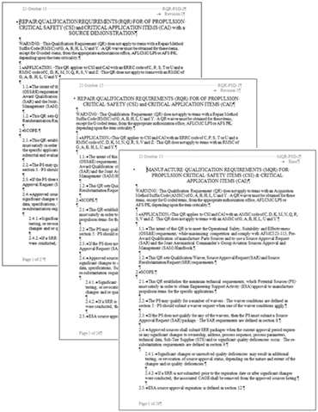
Strategic Sourcing - Source Approval Requests
Increasing competition by facilitating the SAR process to qualify new sources of manufacture and repair
Marketing through SAM.gov
Industry days/conferences
SASPO website - https://www.tinker.af.mil/Home/429SCMS-SASPO/
Driving better quality SARs on right items
Manages an engineering services support contract to assist ESA in qualifying current and new sources of supply and repair
Bowhead Mission Solutions LLC – SAR contractor
1 program analyst & 5 contract engineers supporting 848 SCMG and propulsion
Results: FY12 – FY22 = $57.2M Saved; Reduced processing time
Follow AFMCI23-113 guidance & procedures
Current goals are managed by Tiers: Tier 1 – 30 days, Tier 2 – 60 days, Tier 3 – 90 days, and Tier 4 – 120 days
16
Notes:
(SAR) We assist in increasing the competition by facilitating the Source Approval Request (SAR) process to qualify new sources of manufacture and repair to include; marketing through SAM.gov, Industry Days, Conferences and SASPO Website
Current Savings: $57.2M saved since 2012; Reduced processing & approval times
Tier 1: Highest Priority SARs
Parts impacting depot production on Red War Readiness Engines
Parts having open solicitations
Goal: SAR dispositioned within 30 calendar days
Tier 2: Zero to Single-Sourced SARs
Parts not identified as current depot limiters
Parts with 0-1 existing approved sources
Goal: SAR dispositioned within 60 calendar days
Tier 3: Dual-Sourced SARs
Parts with 2 existing approved sources
Goal: SAR dispositioned within 90 calendar days
Tier 4: Multi-Sourced SARs
Parts with 3 or more approved sources
Goal: SAR dispositioned within 120 calendar days

Slide 9
Strategic Sourcing – Reverse Engineering/Repair Development
Reverse Engineering/Repair Development (RE/RD) program
Reduce Air Force supply chain costs/risks through increased competitive sourcing strategies and focus on creating competition to improve affordability and supportability
RE/RD contract support: 5 total contractors – Hill AFB = 1. Robins AFB = 1 and Tinker AFB = 3
Provide support to IPTs in the development of repairs and reverse engineering projects based on optimizing the supply chain
Hosting and attending industry days and other events to socialize potential projects and supply chain requirements
Potential deliverables: complete technical data package, 3D modeling data, prototype, repair/overhaul instructions, testing requirements, support equipment, etc.
Notes:
3 Primary categories we present at an Industry Day:
Option 1: We own sufficient data to qualify a source; requesting vendors submit Source Approval Request (SAR) package(s). (Specify whether for Repair or New Manufacture)
Option 2: We do not own sufficient data to qualify a source; requesting vendors submit White Papers to assist in project development. (Specify type of project: Reverse Engineering or Repair Development or Additive Manufacturing) Examples of Deliverables: Complete Technical Data Package, 3D Modeling Data, Prototype, Repair/Overhaul instructions, Testing requirements, etc.
Option 3: Market Research – Examples are locating COTS, requesting ROMs, potential source identification, etc.
Project funding available through MPST for budget code 8 (AF) and budget code 9 (DLA) items.

Slide 10
Next Steps After Industry Day
Interested vendors should request any data we own through the Public Sales Office (PSO).
If the quad chart shows we own Engineering Drawings, vendors should request a tracking number from 429scms.saspo.workflow@us.af.mil prior to submitting your data request. Without this tracking number, vendors will be billed the PSOs hourly rate of $272/hr. The tracking number only applies to Engineering Drawings, not Technical Orders (TOs). TOs are $65/TO (specific TO). This cost is set by the PSO, not the SASPO.
Please go to our https://www.tinker.af.mil/Home/429SCMS-SASPO/
and follow the instructions located at the bottom of the vendor resources section on how to request data.
Interested vendors should RSVP to attend Technical Discussion with the Integrated Product Team (IPT), see chart B on the quad chart for details.
Submit White Paper within 60 days of Industry Day to 429scms.saspo.workflow@us.af.mil.

Slide 11
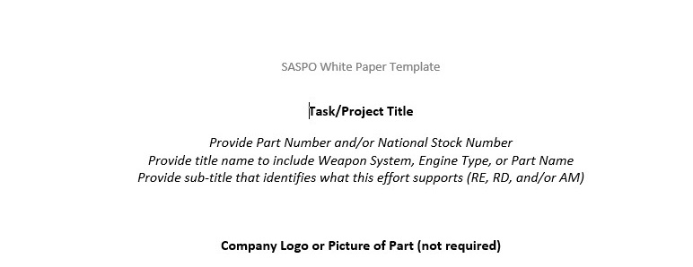
White Paper Guidelines
Purpose – To serve as Market Research, not a formal bid or proposal.
Assist the IPT with project development
Receive engineering feedback
EXAMPLE: https://www.tinker.af.mil/Home/429SCMS-SASPO/
Vendor Resources: White Paper Template

Slide 12
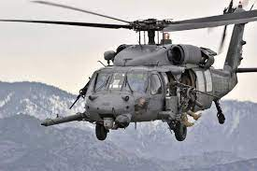

Strategic Sourcing - Sustaining Engineering Program
Provides support for the CSAG-S/GSD engineering projects & Test Program Set (TPS) Software projects that resolve, correct & restore shortfalls & deficiencies for items managed within 448 SCMW & other organizations
Deliverables: Drawings, Redesigns, Tech Data, Prototypes, Test Flight Assets
Enterprise-level policy, guidance, training, & web-based tool (MPST)
Provide program management support
Results
Projected Return-On-Investment: $2.2B
FY25 CSAG Budget $149M
FY25 GSD Budget $4M
FY25 TPS (Test Program Set) Budget $43M
FY18-25 308 projects funded
FY18-25 238 projects completed
CSAG-S/GSD – Consolidated Sustainment Activity Group/General Support Division, MPST - Maintenance Engineering Project Sustainment Tool, MPST – Maintenance Engineering Project Sustainment Tool,
16

Slide 13
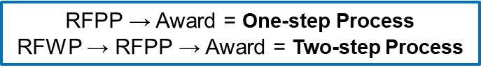

Strategic Sourcing – SCCI OTA
Supply Chain Consortium Initiative (SCCI)
Other Transactional Authority (OTA)
Other Transactions for Prototype Projects (10 US Code 4022)
Purpose is development; tech data, drawings, prototypes, etc.
Scope is USAF weapon systems
All candidates advertised through SOSSEC (Consortium Manager)
Consortium based agreement
Results
35 projects awarded to date; 160 average flow days
23 of 33 projects completed to date
$38M of $99M OTA ceiling obligated
Notes:
What is a prototype project? A prototype project is a proof of concept, model, reverse engineering that allows us to address obsolescence, and apply new and commercially used technologies for defense purposes, it is not limited to a physical asset but can be used to develop an activity, creation, design, even a process including a business process. Basically, to utilize our OTA it must be directly relevant to the Air Force to enhance mission effectiveness of military personnel and supporting platforms, systems, compoManage an Other Transaction Authority (OTA) contract vehicle out of the 448th SCMW. Require access to these systems to check on contracts, pay invoices, review payments, and process requests. nents or materials to be acquired or developed or for improvement of the former utilized by the Air Force.
It is a pretty broad definition, to put it simply “are you developing something”
How long does it take to award an OTA project? Our average is 160 days, from the DoD customer filling out the initial documents for the project package to the project level award to the vendor. From the time the project package is solicited, it is generally 100 days until the project will be awarded. For FY24, we have already awarded 5 projects with an average of 140 days.
Since the OTA is not FAR based, how is it different? It is not a FAR based agreement, but it based out of public law 10 USC 4022. OTAs are agreements, which are similar to contracts however, the SCCI OTA utilizes a consortium-based model. The agreement award was made to SOSSEC inc. SOSSEC solicits the project to the consortium and each project level agreement will be awarded to SOSSEC, and they will award to the vendor that the DoD customer selects. The agreements are firm fixed price and milestone payments are made to track technical progress.
What does the Consortium do and how can you join? The SOSSEC consortium includes over 900 companies with a broad spectrum of members with a wide variety of capabilities, expertise, and technology. SOSSEC acts as the Other transaction lead organization making it a single point of contact for contracting and administration. It allows members the ability to focus on technical performance not business/contracting issues generally required through a FAR based contract.
You can become a member of the consortium by visiting their website, sossecinc.com or by simply googling SOSSEC.
What is the follow-on option for OTA projects? Sole source follow on production contracts may be awarded when competitive procedures were used for the selection of parties for participation in the transaction AND the project was successfully completed. The OTA requires maximum competition, making it fair, transparent, and ethical. The follow on for the first run of a production would be FAR based, meaning a regular production contract. However, it can be awarded sole source because the OTA accomplished the competitive piece.
Are there any current or future projects coming out of SCCI OTA/SOSSEC? For FY24, we awarded 4 Supply Risk Management projects and a circuit card project. We received the proposals for our B-2 Ice Detector Unit project. We have several potential projects in the planning stages for KC-135, B-52 and T-38 for FY24 and FY25.

Slide 14
Strategic Sourcing – SCCI OTA
For AF Customers:
3 documents required to start an OTA
Prototype Request Form, Statement of Objectives and Deliverables
SCCI OTA does not fund projects (Unit-funded, MPST, congressional funds, etc.)
SCCI takes care of contract administration, so AF customers can focus on technical aspects of the project
For Industry:
Companies can join the SOSSEC consortium through their website: https://sossecinc.com/
All solicitations are competitive, however successful prototypes can lead to sole source production follow-on FAR based contracts
There are 8 other OTAs in the SOSSEC consortium for additional project opportunities
Notes:
What is a prototype project? A prototype project is a proof of concept, model, reverse engineering that allows us to address obsolescence, and apply new and commercially used technologies for defense purposes, it is not limited to a physical asset but can be used to develop an activity, creation, design, even a process including a business process. Basically, to utilize our OTA it must be directly relevant to the Air Force to enhance mission effectiveness of military personnel and supporting platforms, systems, compoManage an Other Transaction Authority (OTA) contract vehicle out of the 448th SCMW. Require access to these systems to check on contracts, pay invoices, review payments, and process requests. nents or materials to be acquired or developed or for improvement of the former utilized by the Air Force.
It is a pretty broad definition, to put it simply “are you developing something”
How long does it take to award an OTA project? Our average is 160 days, from the DoD customer filling out the initial documents for the project package to the project level award to the vendor. From the time the project package is solicited, it is generally 100 days until the project will be awarded. For FY24, we have already awarded 5 projects with an average of 140 days.
Since the OTA is not FAR based, how is it different? It is not a FAR based agreement, but it based out of public law 10 USC 4022. OTAs are agreements, which are similar to contracts however, the SCCI OTA utilizes a consortium-based model. The agreement award was made to SOSSEC inc. SOSSEC solicits the project to the consortium and each project level agreement will be awarded to SOSSEC, and they will award to the vendor that the DoD customer selects. The agreements are firm fixed price and milestone payments are made to track technical progress.
What does the Consortium do and how can you join? The SOSSEC consortium includes over 900 companies with a broad spectrum of members with a wide variety of capabilities, expertise, and technology. SOSSEC acts as the Other transaction lead organization making it a single point of contact for contracting and administration. It allows members the ability to focus on technical performance not business/contracting issues generally required through a FAR based contract.
You can become a member of the consortium by visiting their website, sossecinc.com or by simply googling SOSSEC.
What is the follow-on option for OTA projects? Sole source follow on production contracts may be awarded when competitive procedures were used for the selection of parties for participation in the transaction AND the project was successfully completed. The OTA requires maximum competition, making it fair, transparent, and ethical. The follow on for the first run of a production would be FAR based, meaning a regular production contract. However, it can be awarded sole source because the OTA accomplished the competitive piece.
Are there any current or future projects coming out of SCCI OTA/SOSSEC? For FY24, we awarded 4 Supply Risk Management projects and a circuit card project. We received the proposals for our B-2 Ice Detector Unit project. We have several potential projects in the planning stages for KC-135, B-52 and T-38 for FY24 and FY25.

Slide 15
Contact Information
SASPO Website: http://www.tinker.af.mil/Home/429SCMSSASPO.aspx
SASPO Workflow: 429SCMS.SASPO.Workflow@us.af.mil

Slide 16

Questions

Slide 17
